Slide 1



Revision Of Important Topics

Slide 2
Compiler
A compiler is a translator that converts the high-level language into the machine language.
High-level language is written by a developer and machine language can be understood by the processor.
Compiler is used to show errors to the programmer.
The main purpose of compiler is to change the code written in one language without changing the meaning of the program.
When you execute a program which is written in HLL programming language then it executes into two parts.

Slide 3
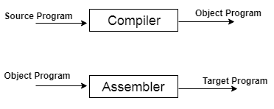
Compiler
In the first part, the source program compiled and translated into the object program (low level language).
In the second part, object program translated into the target program through the assembler.

Slide 4
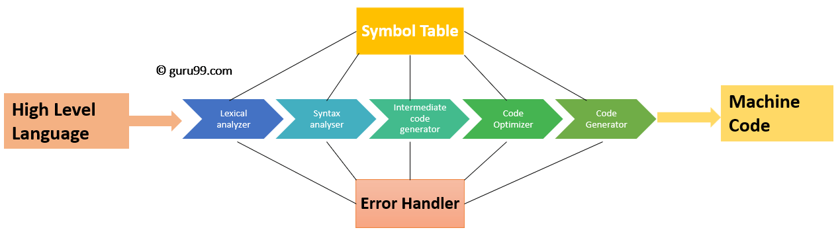
Compiler Phases
The compilation process contains the sequence of various phases. Each phase takes source program in one representation and produces output in another representation. Each phase takes input from its previous stage.

Slide 5
Lexical Analysis
Compiler Phases
Lexical analyzer phase is the first phase of compilation process. It takes source code as input. It reads the source program one character at a time and converts it into meaningful lexemes. Lexical analyzer represents these lexemes in the form of tokens.
Syntax analysis is the second phase of compilation process. It takes tokens as input and generates a parse tree as output. In syntax analysis phase, the parser checks that the expression made by the tokens is syntactically correct or not.
Syntax Analysis

Slide 6
Semantic Analysis
Compiler Phases
Semantic analysis is the third phase of compilation process. It checks whether the parse tree follows the rules of language. Semantic analyzer keeps track of identifiers, their types and expressions. The output of semantic analysis phase is the annotated tree syntax.
In the intermediate code generation, compiler generates the source code into the intermediate code. Intermediate code is generated between the high-level language and the machine language. The intermediate code should be generated in such a way that you can easily translate it into the target machine code.
Intermediate Code Generation

Slide 7
Code Optimization
Compiler Phases
Code optimization is an optional phase. It is used to improve the intermediate code so that the output of the program could run faster and take less space. It removes the unnecessary lines of the code and arranges the sequence of statements in order to speed up the program execution.
Code generation is the final stage of the compilation process. It takes the optimized intermediate code as input and maps it to the target machine language. Code generator translates the intermediate code into the machine code of the specified computer.
Code Generation

Slide 8
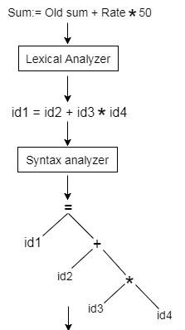
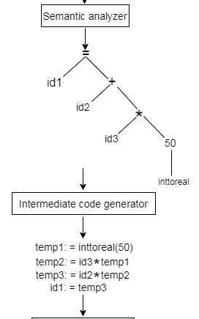
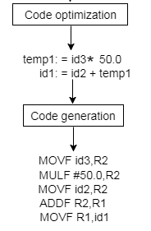
Example:

Slide 9
Compiler Passes
Pass is a complete traversal of the source program. Compiler has two passes to traverse the source program.
Multi-Pass Compiler
Multi pass compiler is used to process the source code of a program several times.
In the first pass, compiler can read the source program, scan it, extract the tokens and store the result in an output file.
In the second pass, compiler can read the output file produced by first pass, build the syntactic tree and perform the syntactical analysis. The output of this phase is a file that contains the syntactical tree.

Slide 10
Compiler Passes
In the third pass, compiler can read the output file produced by second pass and check that the tree follows the rules of language or not. The output of semantic analysis phase is the annotated tree syntax.
This pass is going on, until the target output is produced.
One-Pass Compiler
One-pass compiler is used to traverse the program only once. The one-pass compiler passes only once through the parts of each compilation unit. It translates each part into its final machine code.

Slide 11
Compiler Passes
In the one pass compiler, when the line source is processed, it is scanned and the token is extracted.
Then the syntax of each line is analyzed and the tree structure is build. After the semantic part, the code is generated.
The same process is repeated for each line of code until the entire program is compiled.

Slide 12
Derivation
A derivation is basically a sequence of production rules, in order to get the input string. During parsing, we take two decisions for some sentential form of input:
Deciding the non-terminal which is to be replaced.
Deciding the production rule, by which, the non-terminal will be replaced.
To decide which non-terminal to be replaced with production rule, we can have two options.

Slide 13
Context Free Grammar
Question Number 1:
Consider the context-free grammar:
S -> S S + | S S * | a
Show how the string aa+a* can be generated by this grammar.
Construct a parse tree for this string.

Slide 14
Context Free Grammar
S -> S S + | S S * | a
Show how the string aa+a* can be generated by this grammar.
-> S
-> S S *
-> S S + S *
-> a S + S *
-> a a + S *
-> a a + a *

Slide 15
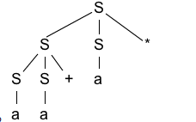
Context Free Grammar
S -> S S + | S S * | a
B. Construct a parse tree for this string.
String: aa+a*

Slide 16
Context Free Grammar
Question Number 2:
What language is generated by the following grammars? In each case justify your answer.
S -> 0 S 1 | 0 1
S -> + S S | - S S | a
S -> a S b S | b S a S | ε

Slide 17
Context Free Grammar
Question Number 2:
S -> 0 S 1 | 0 1
Words of this grammar
S -> 01
S -> 0S1 ->0011
S -> 0S1 -> 00S11-> 000S111-> 0000S1111
So, language is
L = {0n1n | n>=1}

Slide 18
Context Free Grammar
Question Number 2:
2. S -> + S S | - S S | a
Words of this grammar
S -> +SS -> +aa
S -> -SS -> -aa
S -> +SS -> +-SSS ->+-aaa
S -> +SS -> +-SSS ->+-a-SSS ->+-a-aaa
So, language is
L = {Prefix expression consisting of plus and minus signs}

Slide 19
Context Free Grammar
Question Number 2:
3. S -> a S b S | b S a S | ε
Words of this grammar
S -> aSbS -> ab
S -> bSaS -> ba
S -> aSbS -> aaSbSbS ->aabb
S -> aSbS -> aaSbSbS -> aaaSbSbSbaSbS ->aaabbbab
So, language is
L = {String has the same amount of a and b, includes ε}

Slide 20
Context Free Grammar
Question Number 3:
Describe the languages denoted by the following regular expressions:
a(a|b)*a
((ε|a)b*)*
(a|b)*a(a|b)(a|b)
a*ba*ba*ba*

Slide 21
Context Free Grammar
Question Number 3:
a(a|b)*a
Words: aaba,aa,abaa,aba,aaa
Language: String of a's and b's that start and end with a.
((ε|a)b*)*
Words: a,b,aa,abab,abbb
Language: String of a's and b's.

Slide 22
Context Free Grammar
Question Number 3:
3. (a|b)*a(a|b)(a|b)
Words: aaa,bbb,abaaa,abaaa,aabb,ababb
Language: String of a's and b's that the character third from the last is a.
4. a*ba*ba*ba*
Words: bbb,abbb,abababa,aabbaabbaabbaa
Language: String of a's and b's that only contains three b.

Slide 23
Context Free Grammar
Question Number 4:
Identify the tokens in the following program.
int main()
{
// 2 variables
int a, b;
a = 10;
return 0;
}

Slide 24
Context Free Grammar
Question Number 4:
Identify the tokens in the following program.
'int'
'main'
'('
')'
'{'
'int'
'a'
',‘
'b'
';'
'a'
'='
'10'
';'
'return'
'0'
';'
'}'

Slide 25
Context Free Grammar
Question Number 4:
Identify the lexemes that make up the tokens in the following program.
#include <stdio.h>
int maximum(int x, int y) {
// This will compare 2 numbers
if (x > y)
return x;
else {
return y;
}
}

Slide 26
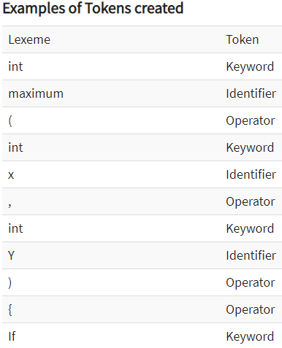
Context Free Grammar
Question Number 4:

Slide 27
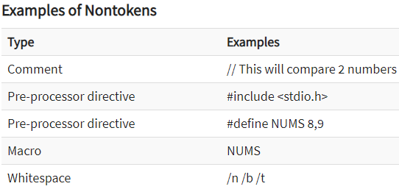
Context Free Grammar
Question Number 4:

Slide 28
Formal Grammar
Formal grammar is a set of rules. It is used to identify correct or incorrect strings of tokens in a language. The formal grammar is represented as G.
Formal grammar is used to generate all possible strings over the alphabet that is syntactically correct in the language.
Formal grammar is used mostly in the syntactic analysis phase (parsing) particularly during the compilation.

Slide 29
Formal Grammar
Formal grammar G is written as follows:
G = < V, N, P,S >
Where:
N describes a finite set of non-terminal symbols.
V describes a finite set of terminal symbols.
P describes a set of production rules
S is the start symbol.

Slide 30
Formal Grammar
Example:
L={a,b},N={S,R,B}
Production Rules:
S = bR
R = aR
R = aB
B = b

Slide 31
Capabilities of CFG
There are the various capabilities of CFG:
Context free grammar is useful to describe most of the programming languages.
If the grammar is properly designed then an efficient parser can be constructed automatically.
Using the features of associatively & precedence information, suitable grammars for expressions can be constructed.
Context free grammar is capable of describing nested structures like: balanced parentheses, matching begin-end, corresponding if-then-else's & so on.

Slide 32
Thank You

